Slide 1
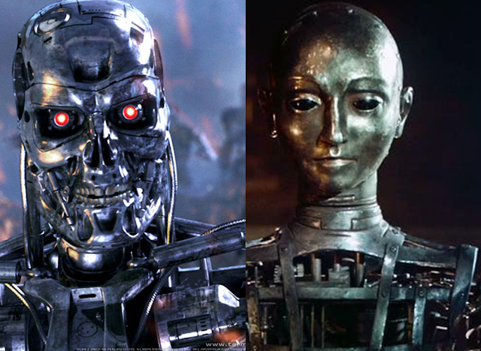
Theory Of Automata
<number>
Notes:
<number>

Slide 2
Lecture # 05
Theory of Automata
<number>

Slide 3
Revision
Languages
Types of languages
Method of defining languages
Descriptive definition
Palindrome
Recursive way
<number>

Slide 4
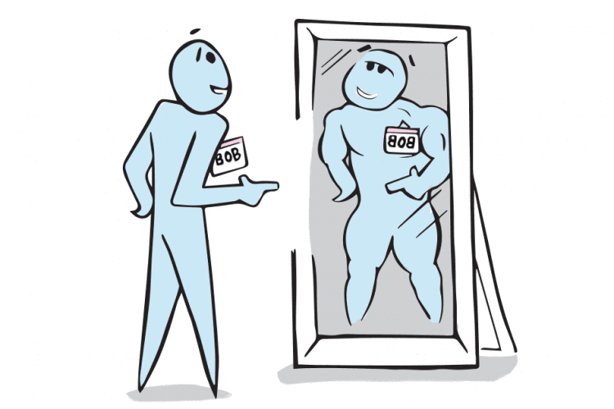
Palindrome
The language consisting of Λ and the strings s defined over Σ such that Rev(s)=s.
It is to be denoted that the words of PALINDROME are called palindromes.
<number>

Slide 5
Example:
For Σ={a,b},
PALINDROME={Λ , a, b, aa, bb, aaa, aba, bab, bbb, ...}
Null string is also a palindrome
<number>

Slide 6
2:Recursive Equation
One of the language defining method.
Fundamentally a three-step process
Rule#1:
Specify some basic objects in the set.
The number of basic objects specified must be finite.
Some basic facts about the set are written.
<number>

Slide 7
Rule#2:
Give a finite number of basic rules for constructing more objects in the set from the ones we already know.
Rule#3:
Provide declaration that no objects except those constructed in this way are allowed in the set.
<number>

Slide 8
Examples
Defining language of INTEGER
Rule 1: 1 is in INTEGER.
Rule 2: If x is in INTEGER then x+1 and x-1 are also in INTEGER.
Rule 3: No strings except those constructed in above, are allowed to be in INTEGER.
<number>

Slide 9
Defining the language L, of strings beginning and ending in different letters , defined over Σ={a, b}
Rule 1: ab and ba are in L
Rule 2: (a)s(b) and (b)s(a) are also in L, where s belongs to Σ*
Rule 3: No strings except those constructed in above, are allowed to be in L
<number>

Slide 10
More Examples
<number>

Slide 11
Consider the language of factorial:
Rule 1: We know that 0!=1, so 1 is in factorial.
Rule 2: Also n!=n*(n-1)! is in factorial.
Rule 3: Thus, no strings except those constructed in above, are allowed to be in factorial.
<number>

Slide 12
Let PALINDROME be the set of all strings over the alphabet = {a, b}
PALINDROME = {w : w = reverse(w)} = {Λ, a, b, aa, bb, aaa, aba, bab, bbb, aaaa, abba, . . .}
A recursive definition for PALINDROME is:
Rule 1: , a, and b are in PALINDROME.
Rule 2: If w 2 PALINDROME, then so are awa and bwb.
Rule 3: No other string is in PALINDROME unless it can be produced by rules 1 and 2.
<number>

Slide 13
Regular Expressions
One of the most common language defining method.
Provide concise matching of string.
Language is represented in terms of strings.
The concept is associated with the Kleenes formalism of regular sets introduced in 1950
<number>

Slide 14
Most implied language defining method
Used in so many programming languages including Java , C++ etc
One regular expression can define the whole language i.e. how many number of infinite strings a language has
It squeeze the infinite language in to a single expression.
<number>

Slide 15
Examples
Make a language contain all of the strings of ‘a’ only.
L={a,aa,aaa,aaaa,aaaaa,……..}
R.E = a+
Make a language contain all of the strings starts with ‘a’ and ends on any ‘b’.
L={a,ab.abb,abbb,abbbb,……}
R.E = ab*
<number>

Slide 16
Operators to define R.E.
Useful operators used in the regular expression are:
* = 0 or more
+ = 1 or more
<number>

Slide 17
a|b = a or b
(a|b)* = (a or b) 0 or more times
(a|b)⁺ = (a or b) 1 or more times
a|b* = a or b (only b 0 or more times)
(a|b)*(c|Λ) = (a or b) 0 or more times and c or Null string
<number>

Slide 18

Lecture Summary
Recursive way
More Examples
Class Assignments
Regular Expressions
Examples of RE
Operators used in RE
<number>

